Slide 1
Introductory Programming and Problem-Solving Skills
Week-11

Slide 2
Previous week discussion
Exceptions and Exception Handling
Raising manual Exception
Catching single and Multiple Exception
Try , Except, Else and Finally

Slide 3
Algorithms

Slide 4
Some popular algorithms and their implementation
Searching algorithms
Sorting algorithms

Slide 5
Searching: Linear-Search
Linear Search is a simple searching algorithm that sequentially checks each element in a list until a match is found.
Working procedure: Iterate through each element, comparing with the target until a match is found or the end is reached.
Use Cases: Effective for small datasets and unsorted lists

Slide 6
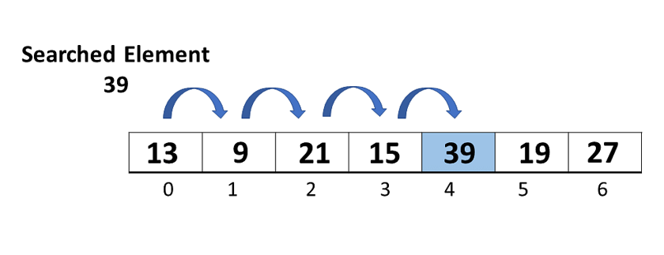
Searching: Linear-Search

Slide 8

Example-Linear Search
# Example:
example_list = [5, 8, 2, 10, 15, 7, 3]
target_element = 15
result = linear_search(example_list, target_element)
if result != -1:
print(f"Element {target_element} found at index {result}.")
else:
print(f"Element {target_element} not found in the list.")
def linear_search(list_var, target):
for i in range(len(list_var)):
if list_var[i] == target:
return i # Return the index if the target is found
return -1 # Return -1 if the target is not in the list
Output

Slide 9
Limitations and advantages
Limitations:
Inefficient for large datasets especially if the target is near the end
Advantages:
Simplicity, easy to understand and implement
Can be done on both ordered or unordered structure or string

Slide 10
Searching-Ordered Structure Binary Search
If the string or list is ordered (e.g., 'abcdefgh'), there is another alternative to searching every element to look for a specific letter.
We can use the divide-and-conquer strategy:

Slide 11
Searching-Binary Search
def ordered_find(c, string):
start = 0
end = len(string)-1
while True:
mid = (start + end)//2
if c == string[mid] :
return mid
if start == end :
return -1
if c < string[mid] :
end = mid-1
else :
start = mid +1
search for a character c in a sorted string.
start index is set to 0 and the end index is set to the last index of the string (len(string) - 1)
While loop is used until the char is found
middle index is calculated as the average
If the character is less than the character at the middle index, the search range is narrowed
The loop then continues with the narrowed search range until the character is found

Slide 12
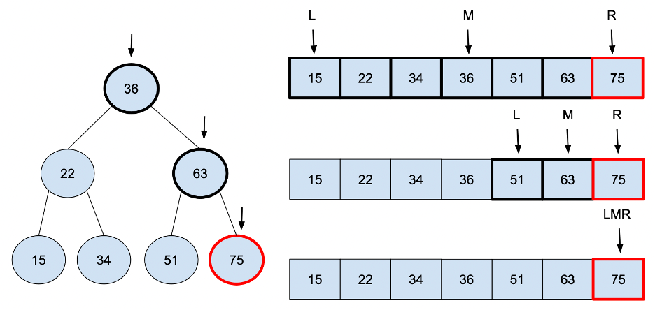
Binary Search

Slide 14
Advantages and Limitations
Advantages:
Faster than common linear search as it uses divide and conquer method
Limitations:
Can't perform any operation if data is not sorted.

Slide 15
Sorting
Process of arranging elements or data.
Establishes a specific order, such as ascending or descending.
Aims to bring organization to a collection of items.
Facilitates efficient searching, retrieval, and analysis of data.
Fundamental operation in computer science and algorithms.

Slide 16
Approach of sorting
Since having a ordered/sorted list can be very useful in a lot of situations in processing data, efficient algorithms for sorting data are important. When presented with an unordered list :
abc = ['b', 'd', 'e', 'a', 'c']
one of the simplest ways of sorting this list is just to go through the list from start to end, and look for the lowest letter in the list. When you reach the end of the list, swap the lowest letter with the letter at the front of the list.
abc = ['a', 'd', 'e', 'b', 'c']
Then start that process again from the second position in the list and search through the list again for the next lowest letter, and then swap that with the second position, and so on.
abc = ['a', 'b', 'e', 'd', 'c']
abc = ['a', 'b', 'c', 'd', 'e']
abc = ['a', 'b', 'c', 'd', 'e']
abc = ['a', 'b', 'c', 'd', 'e']
This is called the Selection Sort algorithm, and it is very inefficient. Its time complexity is O(n²).

Slide 17
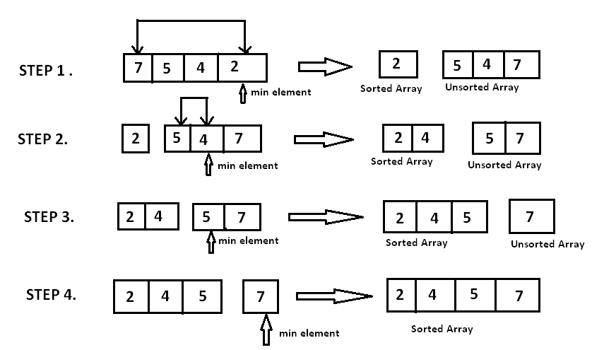
Selection Sort

Slide 19

Example-Sorting
def selection_sort(arr):
n = len(arr)
for i in range(n):
# Find the minimum element in the unsorted part of the list
min_index = i
for j in range(i + 1, n):
if arr[j] < arr[min_index]:
min_index = j
# Swap the found minimum element with the first element of the unsorted part
temp = arr[i]
arr[i] = arr[min_index]
arr[min_index] = temp
# Example:
abc = ['b', 'd', 'e', 'a', 'c']
# Print the original unsorted list
print("Original List:", abc)
# Perform Selection Sort
selection_sort(abc)
# Print the sorted list
print("Sorted List:", abc)
Output:

Slide 20
Recursion
Recursion is all about "Divide and Conquer"
Breaking a problem down to its smallest step, applying a simple solution, and then stepping back and applying the same solution to bigger and bigger versions of the problem
However, not all problems can be solved this way
Sometimes it is more elegant to solve a problem recursively, but it may not be the most efficient way.

Slide 22
Recursive Function
Recursion is implemented in programming languages through functions or methods that call themselves during their execution.
When a function calls itself, it creates a new instance of the function. Each instance has its own set of parameters, local variables, and execution context.
To avoid infinite recursion, the code must include a termination condition. This condition is a base case that determines when the function should stop calling itself and return a result.
The termination condition is usually reached when the problem has been reduced to its simplest form or a single step that can be directly solved without further recursion.

Slide 23
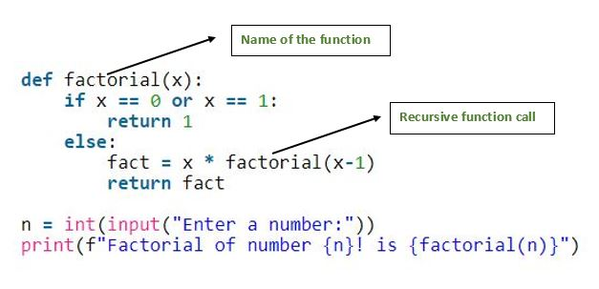
Example Recursive Function

Slide 24
Merge Sort recursive Algorithm
Merge Sort is a sorting algorithm that follows the divide-and-conquer paradigm. It works by dividing the input array into
two halves, recursively sorting each half, and then merging the sorted halves back together. The key steps are:
Divide: Split the unsorted array into two halves.
Conquer: Recursively sort each half.
Merge: Merge the sorted halves to produce a single sorted array.

Slide 25
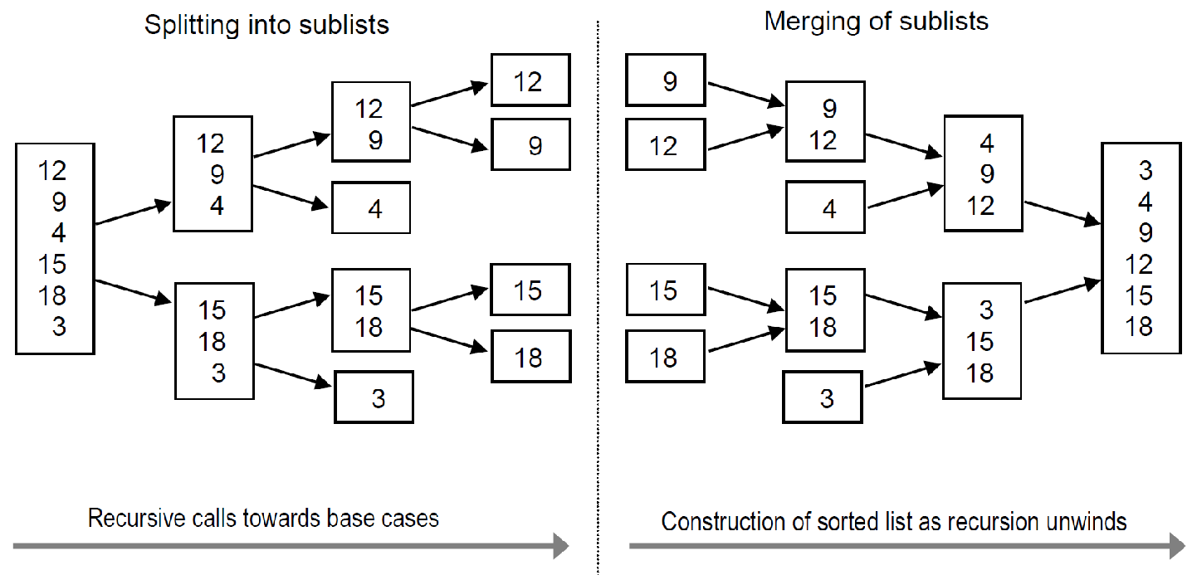

Merge sort

Slide 27
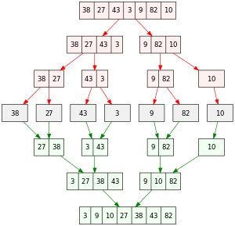
Merge Sort

Slide 28
Tower of Hanoi
The Tower of Hanoi is a classic problem that can be solved using recursion and follows the divide-and-conquer strategy.
The problem consists of three rods and a number of disks of different sizes, which can be slid onto any rod.
The puzzle starts with the disks in a neat stack in ascending order of size on one rod, the smallest at the top, thus making a conical shape.
The objective of the puzzle is to move the entire stack to another rod, obeying the following simple rules:
Only one disk can be moved at a time.
Each move consists of taking the upper disk from one of the stacks and placing it on top of another stack or on an empty rod.
No disk may be placed on top of a smaller disk.

Slide 29
Tower Of Hanoi

Slide 30
Exercise
Write a Python program to calculate the sum of a list of numbers using recursion.
Write a Python program to convert an integer to a string in any base using recursion .
Write a Python program to solve the Fibonacci sequence using recursion.

Slide 31
Exercise
Write a Python program to get the factorial of a non-negative integer using recursion.
Write a Python program to sum recursion lists using recursion. Test Data: [1, 2, [3,4], [5,6]] Expected Result: 21

Slide 32
End of Module
Good Luck!!!

